Slide 1
Task Manager

Slide 2
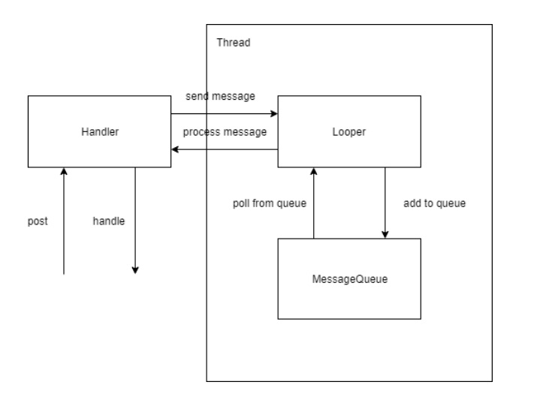
Design 1

Slide 3
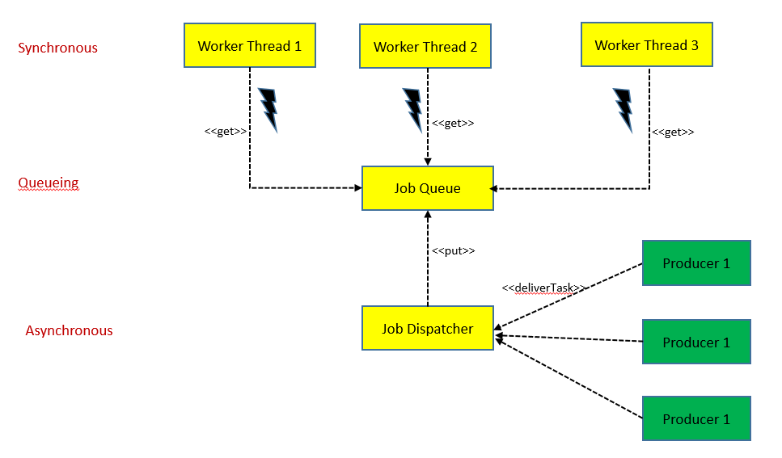
Design 2

Slide 4
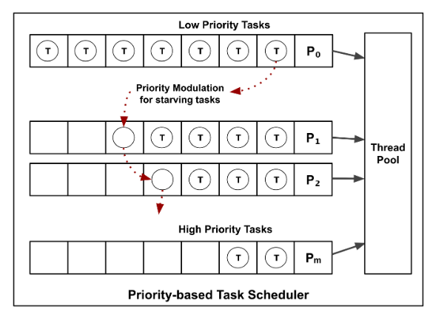
Design 3
Notes:
- Allocate thread on demand> if all job finish, exit thread. If many job and all thread are busy, allocate new thread (< max threads)

